Slide 1
intelligent BUSINESS for CPG’S

Slide 2
EVERY BUSINESS EXPERIENCES SOME FORM OF DISRUPTION
RELEASING TREMENDOUS ECONOMIC OPPORTUNITIES
AND THREATS
Last year, the top 25 U.S. food and beverage companies drove 45% of category sales — but only 3% of growth.
The remaining 97% of sales growth was driven by smaller players.
Notes:
Look at business disruption. Every business is under pressure to meet new, ever-changing, customer and shareholder expectations. The pace of change is accelerating every year and those who aren’t able to adapt to change and expectations become irrelevant: Since 2000, 52% of the Fortune 500 companies are no longer on the list.
Analytics and AI are today’s driving forces of disruption and shake up all businesses:
By creating new markets, channels, and customer value propositions based on different commercial structures, pricing models, and customer interactions. (?) .
By applying digital tools to create an intelligent enterprise capable of making better decisions, in real time, at scale, across the business.
By blurring industry boundaries, disrupting the historical basis of competitive advantage, and leveraging eco-system partners to create new advantages. (?)
And because of enhanced technology (? Data analytics? ), disruption can come from anywhere, at any time, in any form. [Seems a bit repetitive. I suggest we remove unless there is something new we’d like to say about data analytics and disruption.]
[Overall, the three points (above) are a bit vague. I think I broadly understand what is trying to be said but am not quite sure... Is there a way to simplify it? Happy to hop on a call to talk through the above points and edit together!]
Additional points:
74% of industry executives surveyed for the Accenture Technology Vision 2017 said that their organization is entering entirely new digital industries, some of which have yet to be defined.
By 2020, 1.7 megabytes of new information will be created, every second, for every human being
70-85% of enterprises’ data remains trapped and unused.

Slide 3

IN RESPONSE COMPANIES MUST BECOME INTELLIGENT BUSINESSES…
NEW PERSPECTIVE
Sense, Interpret, Augment
AND EMBED ANALYTICS INTO THE CORE OF EVERY PART OF THEIR BUSINESS
TO DO THINGS DIFFERENTLY AND DO
TO DO THINGS DIFFERENTLY AND DO DIFFERENT
THINGS
DATA
FAST
APPLIED
INTELLIGENCE
TECHNOLOGY
AI / DATA SCIENCE
NEW DIALOGUE
Access, Collaborate, Connect
NEW APTITUDE
Act, Learn, Optimize

Slide 4
PIVOT TO THE NEW
…To Unlock NEW VALUE
With the POWER of Data & INSIGHTS
intelligent
Brand Building
intelligent
Revenue Growth
INCREASE
REVENUE
intelligent
Supply Chain
3-8%
TRANSFORM
CORE
BUSINESS
MORE AGILE SERVICE
AT REDUCED COST
TRAPPED
VALUE
EXPAND MARKET SHARE
ACCELERATE
TIME TO MARKET
DRIVE INNOVATION
AGENDA
4
Notes:
Many companies tend to think transformation is all about scaling your business, adding new offerings for clients – but often they are overlooking what’s already there – the trapped value that exists – from data, from creating new efficiencies in operations through the power of intelligence. Unlocking this trapped value can open up capital to invest in the new.
The majority of our clients have a strongly entrenched business model which they have to protect, and at the same time they have to start investing in the new. To free up capital and pivot to the new, businesses must unlock the trapped value in their current legacy systems and processes. And like we said, unlocking this value requires more than a digital strategy; it requires being digital at the core.
Innovations in analytics and technology have the power to open an abundance of economic possibilities that were previously hidden or unreachable in our clients’ legacy business, while helping them create new data driven business opportunities to take advantage of new markets.
POSSIBLE ADDITION – While many CDO’s/CAO’s struggle to demonstrate ROI on analytics investments, unlocking this trapped value consistently demonstrates high return

Slide 5
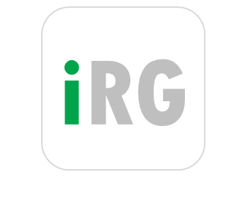

intelligent REVENUE GROWTH for CPG’S

Slide 6





LEADING CPG COMPANIES ARE EXPECTED TO WIN THE BATTLE ON TWO FRONTS: EFFECTIVE COST MANAGEMENT AND DRIVING PROFITABLE REVENUE GROWTH
The old opportunities have already been captured
Growth is still out there – but HARDER to achieve
Globalization
Low-hanging fruit in cost productivity
Endless premiumization in developed markets
Rampant emerging market expansion
Global Tax Efficiency
Volumes
Consumer Price
Revenue Growth Management
Minimum Retailer margin
List Price
Trade spend
Net Revenue
COGS Mix
Zero Based Budget
Global Business Services
COGS
Gross Margin
SG&A
Net Margin

Slide 7

REVENUE MANAGEMENT FRAMEWORK ENABLING FAST, HIGH QUALITY INSIGHTS AND COMMERCIAL DECISIONS ACROSS ALL REVENUE MANAGEMENT PILLARS
Deliver Profitable Top Line benefits worth 3% - 8% of Net Sales
Mission: Drive value and profit growth ahead of the market
Realign Resources to New Brand, Channel, Customer, Outlet Strategy and Profit Pool
Understand the general context of the market we operate, benchmark our RM performance to our competitors
Consumer & Brand Pricing
Pack Price
Architecture
Trade Promotion
Mix & Assortment
Trade Terms
Capture the full value of our brands and optimize innovation pricing
Right format, right pack, right price: for each occasion, channel and shopper mission
Right frequency, depth and feature by channel and retailer
Drive our brand / pack / channel / customer mix to where the profit and growth are
Defensible pay-for- performance that motivates & rewards the behavior we seek
Single Version Of Truth – Visibility on Past Performance
Automate data cleansing and harmonization, prepare for wider data linkage (i.e. digital, SFA, DDE), establish a common data repository acting as a single source of truth for RM

Slide 8
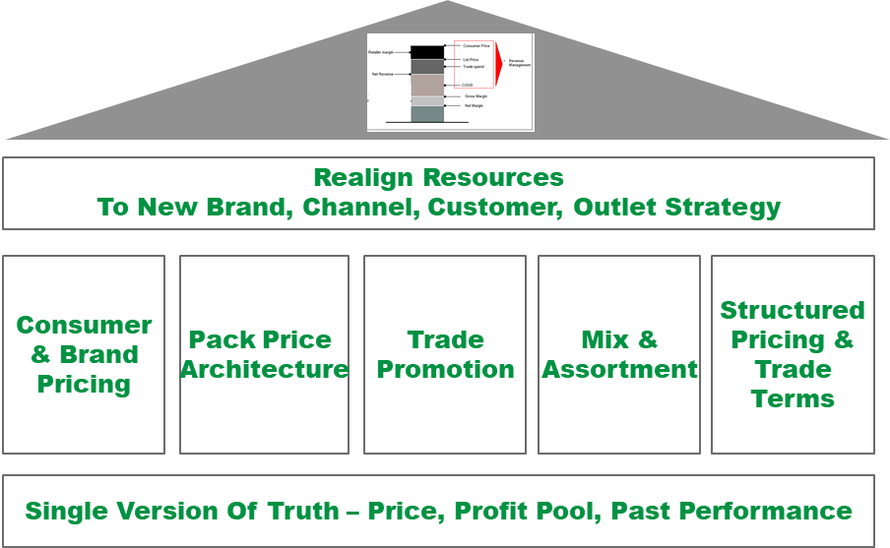
POWERING DECISION MAKING FOR SUPERIOR EXECUTION for each and different Trade ChannEl (R2M)
Insights to
Action
intelligent IDENTIFICATION of OPPORTUNITIES
& OPTIMIZATION OF VALUE PROPOSITION
INTELLIGENT
SALES
EXECUTION
MT
By PoS/Segment
SEGMENTED
&
GRANULAR TARGETS
TT
Trade Channels
DT
Where is the Growth?
Strategic
Prioritization
Opportunity
Spotting
Optimized
Resource
Planning
Simulation for
Execution
to Target
eT
Performance Insights
Back Testing

Slide 9
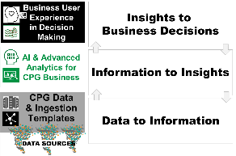

Industrialized revenue management enables the sales TEAM in EMBEDDING the ANALYTIC INSIGHTS into PLANNING and execution
Insights to
Action
INTELLIGENT IDENTIFICATION OF
OPPORTUNITIES & OPTIMIZATION OF VALUE PROPOSITION
INTELLIGENT
SALES
EXECUTION
SEGMENTED
&
GRANULAR PLANS
TPM
In Store
Execution
(SFA)
Insights Platform
+
Insights AdvisoryTower
Indirect Distribution
On Line
Execution
(eCommerce)
Performance Insights
Back Testing

Slide 10
POWERING DECISION MAKING FOR SUPERIOR EXECUTION
Insights to
Action
INTELLIGENT IDENTIFICATION OF OPPORTUNITIES & OPTIMIZATION OF VALUE PROPOSITION
INTELLIGENT
SALES
EXECUTION
MT
Marketing (ATL)
/
Trade
(BTL)
Mix Optimization
-
ROI
PEA – Promo ROI Insights
Optimizer
and
What-if scenario simulator
TPM
In Store
Execution
(SFA)
By PoS/Segment
SEGMENTED
&
GRANULAR PLANS
TT
TPO - Promotion & B2B Price Optimization
Trade Channels
Indirect Distribution
Growth Value Targeting
POS Segmentation Benchmarking, Potential
B2C Price
Insights & Optimization
Sales Decomposition (Baseline, & other effects)
DT
Assortment
Insights & Optimization
On Line
Execution
(eCommerce)
In Store Activities Insights & Optimization
eR
Trade Terms Insights & Governance
Performance Insights
Back Testing

Slide 11

What is behind

Slide 12





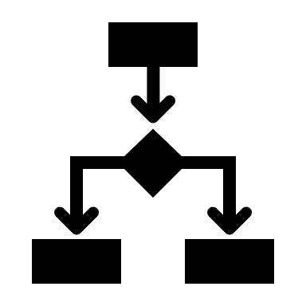



CPG IRG Architecture on AZURE & nvidia dgx
Business Intelligence
Knowledge Brain: SQL and Neural Networks
Legend
Client Engagement
Optional
A-I Web Service
Data Factory / Spark
Data Lake/WH
Databricks / Spark /
Cloud A-I Services
Knowledge Transformation
Azure
Kafka
Graph DB Connector
Streaming Source
Streaming Source
Topic Model
Knowledge Graph DB
Deep Learning
Graph-Based Hierarchical Clustering
DB Source
DB Source
Nvidia DGX
Image Source
Image Source
Keras Deep Learning Framework
OCR
Data Correction
Document Source
Document Source
Missing Data Services & Anomaly Detection
GloVe
External Rich Data Source
External Rich Data Source

Slide 13
transformation, cleansing and expansion implementation on AZURE
Data Lake/WH
Azure
Nvidia DGX / Spark
OCR
GloVe for Data Expansion
Distributions of word-word co-occurrences from pre-trained GloVe model
Marginals in chosen GloVe model detail distribution of all other words with given word
DBN to learn global distribution of word-word co-occurrences from marginals
Marginals of global distribution are elements in conditional specification
Global distribution identifies word associated to each specific marginal
Expanded data set gives more detailed insights
Legend
Optional
Image Source
Streaming Source
DB Source
Document Source
Missing Data Services
DBN for character-based data correction activities
External Rich Data Source

Slide 14
Knowledge graph implementation on AZURE & nvidia dgx
Nvidia DGX / Spark
Cosmos DB
Azure
Knowledge “Brains”
DBN for hierarchical clustering of threat vector data streams
Expanded data are properties of threat vectors in each leaf of the hierarchy
Each leaf in the child hierarchy defines a distribution in the conditional specification of the global distribution top leaf
Each subset of all columns as the data set in the top leaf leads to a hierarchy that defines a “brain”
Knowledge Graphs and A-I Service
Each knowledge “brain” forms a separate graph when each 2 threat vectors in a leaf node connect to form an edge in the graph
Properties give additional details about each threat vector and allow the threats to be searched via SQL statements
Each leaf defines ranges for each property, so-called association rules
Memory-variable-SQL statement association models identify possible buffer-overflow and SQL injection threats
A-I service can be implemented as a SQL call on the properties of a particular “brain” and associated leaf with its conditional distribution
Legend
Optional
Transformed, Cleaned and Expanded Data

Slide 15







iRG TECHNOLOGY STACK
- iRG Layers -
- What it is, how it helps -
- Technology stack -
Business Scenarios Prediction & Simulation
intelligent Apps 4 decision making
Decision Support – “So What ?”
embedded predictive and optimized recommendation
Insights to Biz Decisions
Visualization
Self-service Analysis visualization
Analysis, Reporting & Communication
Next Best Action and revised Targets tuned by decision makers above
Advanced Analytics
building blocks for modeling & processing analytics applications
Deep Learning and Machine Learning Algorithms
Learn cause-effect from multiple historical data and predict/optimize future effect
By PoS/Segment
Powered by AIP*
Storage
Validated, Analytical Storage
Information to Insights
Granular DATA – Data Lake & DWH
Cleansed, Harmonized, Certified for Analysis & Advanced Analytics and Raw data
Data Ingestion
Data capturing & Integration
Data Acquisition Toolsets
Traditional ETL for structured data
Flex Ingestion/Streaming for unstructured data
Cloud
Cloud infrastructure & Security
Data to Information
Cloud Technical Infrastructure
Provides the technical environment for all components above, with Flexibility in sizing, usage & Security
Data Sources
(and Execution Systems)
ERP, Sales Force Automation, TPM, External data, ..
All Client source systems providing raw data to feed above layers and enable analysis
Internal and External Data
*Accenture Insights Platform is flexible to host multiple technical solutions in all layers (i.e. Hadoop, Tableau, QlikView, ..)

Slide 16


intelligent Revenue Growth
Business Scenarios Prediction & Simulation
intelligent Apps 4 decision making
Insights to Business Decisions
Decision
Output
Business Optimizers & What-if scenario simulators
Marketing (ATL)
/
Trade
(BTL)
Mix Optimization
-
ROI
Visualization
Self-service Analysis visualization
Insights to Biz Decisions
Volume Decomposition (Baseline, & other effects)
TPO - Promotion &
B2B Price Optimization
POS Segmentation Benchmarking, Potential
PEA – Promo ROI Insights
B2C Price
Insights & Optimization
Assortment
Insights & Optimization
In Store Activities Insights & Optimization
Trade Terms
Insights & Governance
Advanced Analytics
building blocks for modelling & processing analytics applications
Information to Insights
Approved Decision
(Plans)
Modeling Cockpit
Advanced Models Configuration
Storage
Validated, Analytical Storage
Information to Insights
Granular QUALIFIED Analytic Data Storage
Enriched & Integrated Data
Customer Analytical Record
Time Series on same Master data
TRANSFORMATION
Data Ingestion
Data capturing & Integration
STAGING , HARMONIZATION & DATA LAKE
Data Harmonization
Data Cleansing
Data Quality Workbench
Data to Information
Predefined Interfaces & Loaders
Cloud
Cloud infrastructure & Security
Data to Information
Data Sources
(and Execution Systems)
ERP
Sales
Force Automation
Trade Promotion
Management
“External Data”
Retailers, Syndicated, etc.
Distributor Management Systems
Marketing Campaign /
Loyalty
eCommerce
Social Media
Behavioural Data
Insights
to Action
(targets)

Slide 17
appendix

Slide 18
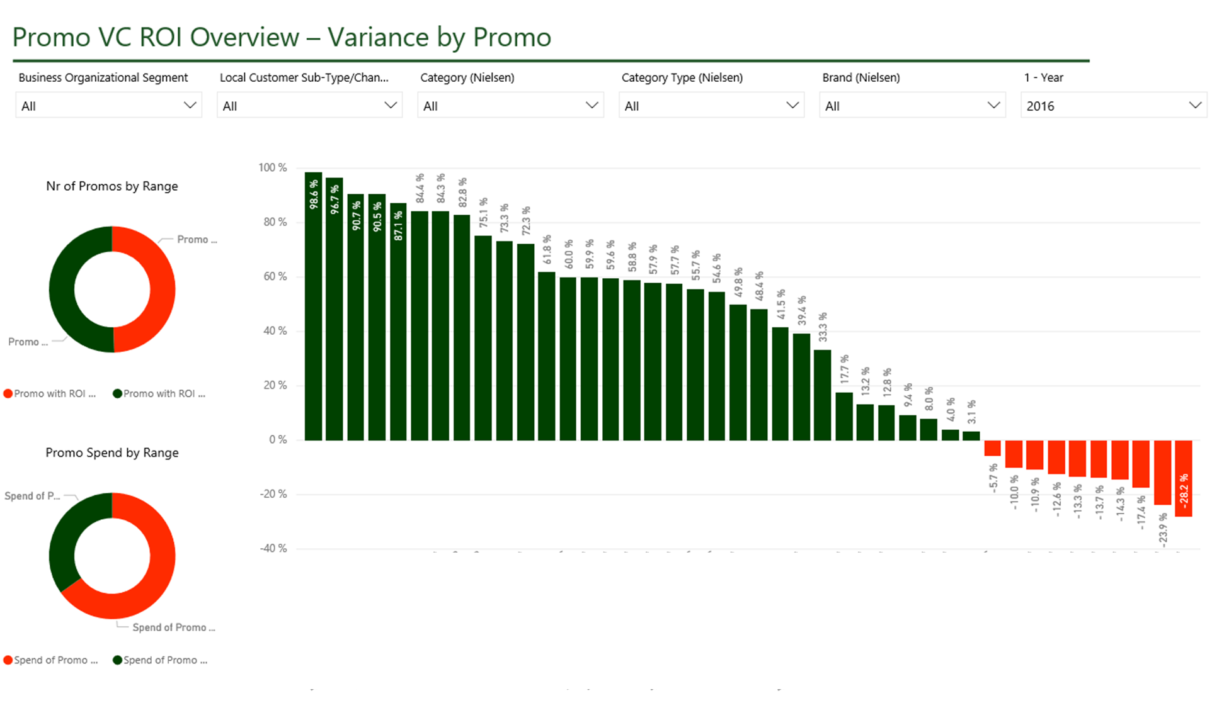
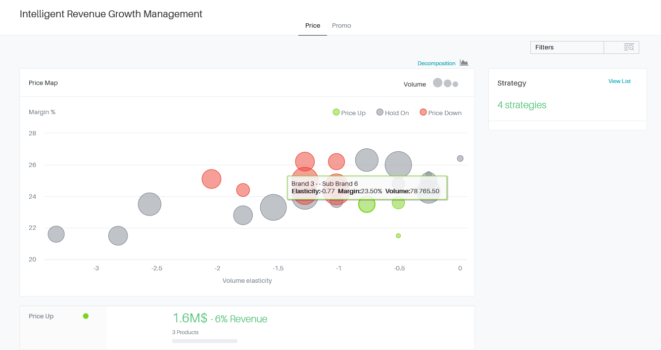

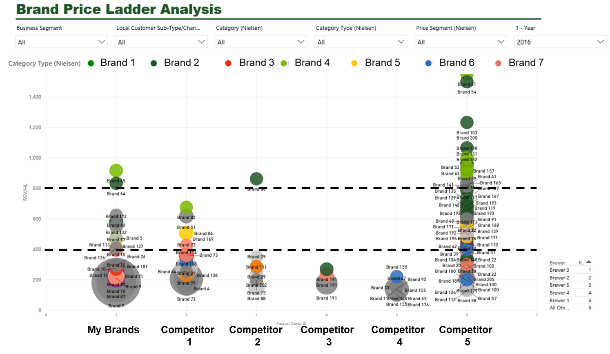
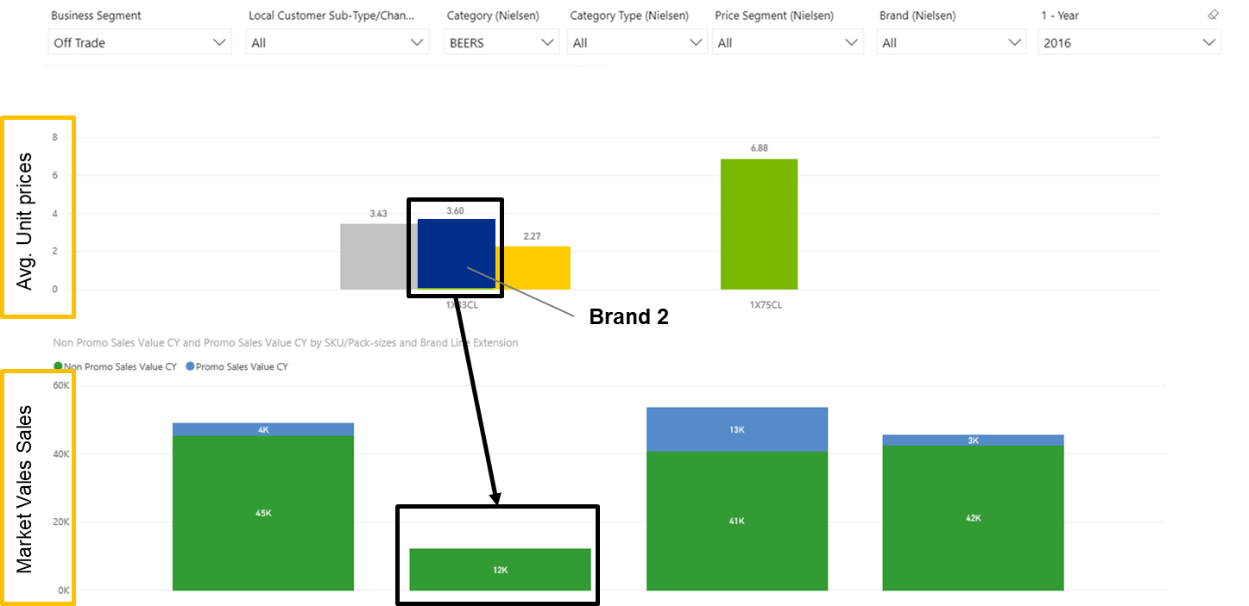
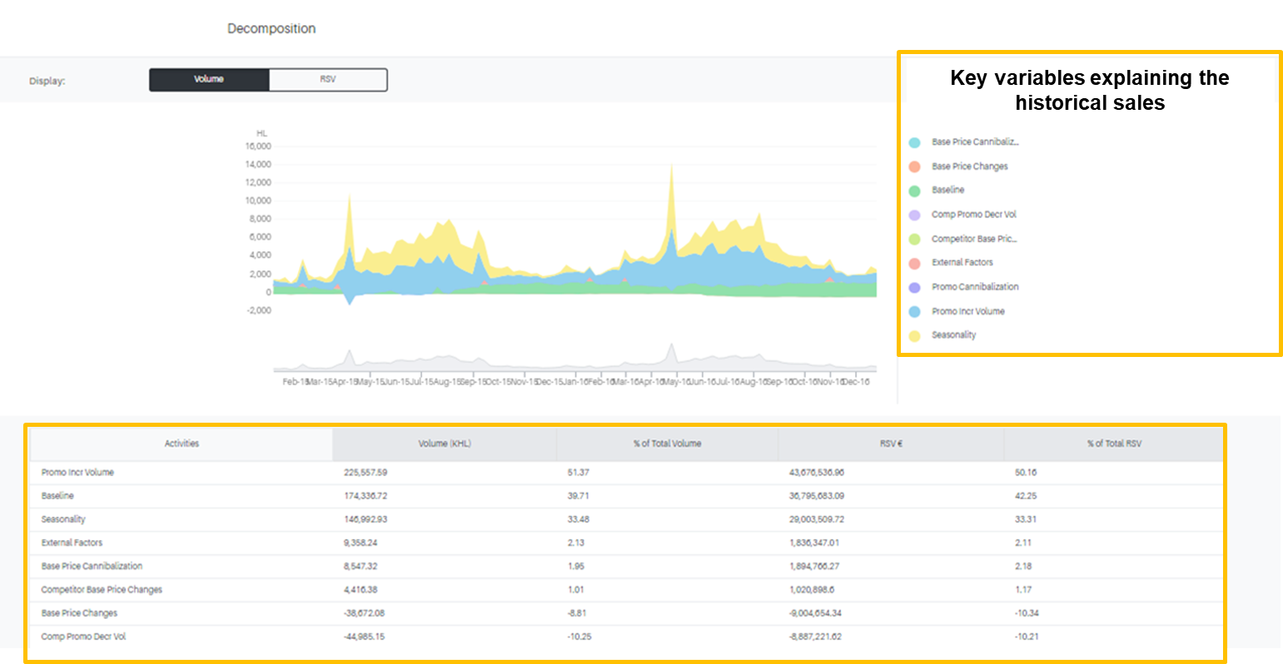
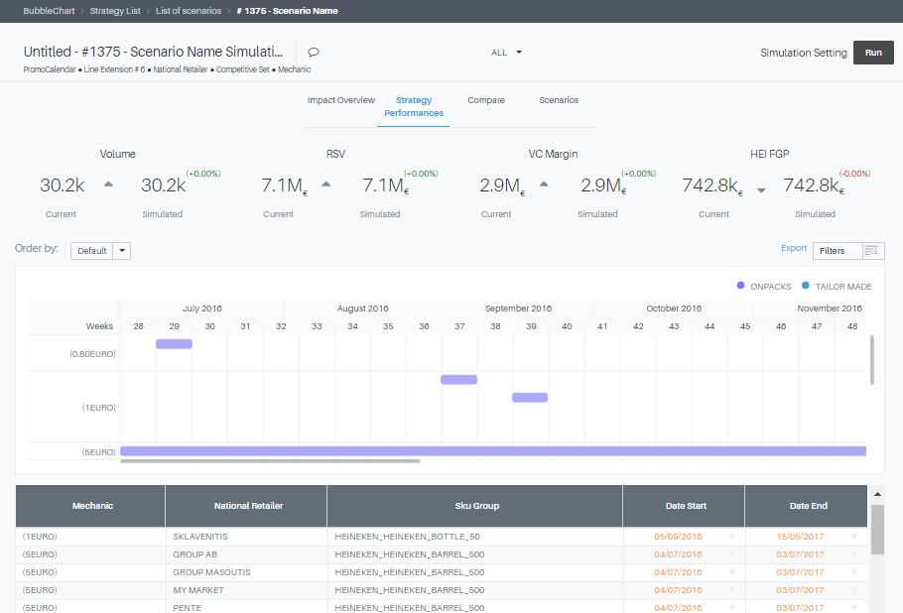
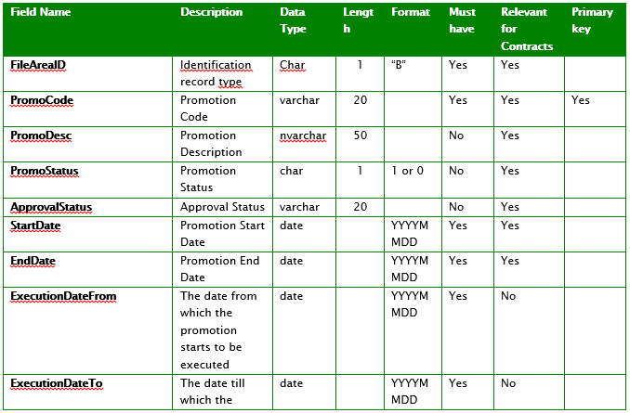
HOW DO WE APPROACH IT (1/2)
OUR PROPOSED APPROACH IS BASED ON AN ITERATIVE WAVED DEPLOYMENT AND AGILE EXECUTION. THIS ENABLES THE BUSINESS COMMUNITY TO SEE VALUE AT AN EARLY STAGE OG THE JOURNEY
Play and Learn
- Inputs -
- Functional Design -
- Play and Learn Waves -
- Business validation -
- Outputs -
Wave 1
Wave 2
Wave 3
Productive enablers for business use
AS-IS playbook & tools
Deep dive on enablers in scope to define look & feel, KPIs’ formula, level of analysis, ..
Finalize mock-ups as input to configuration
Update list of functional requirements
Identify data needs and integration points
Configure and tune the enablers
Data loading and test
Demo and training of enablers by wave
User testing of enablers
Gather feedbacks from business users
Assess and implement feedbacks (where possible)
Business validation of the enablers’ behavior versus agreed functional specs
No critical defects open
Data validation (limited to a data subset)
List of improvement points
iRG platform & enablers
Critical points for E2E testing
Iterative feedback
Iterative feedback
Data collection
- Inputs -
- Data Preparation -
- Data Extraction and Loading -
- Data Validation -
- Outputs -
Agreed data set / scope
Iterative data tuning
Iterative data tuning
Subset of productive data accessible
Review data needs for the key enablers in scope for the waves
Fine tune data interface format request
Extract data file and prepare data file for loading
Validated data file for loading
Data load and extraction from platform for quality check
Tune and refresh data for reports and views enablement where required
Validate subset of data loaded
List data interface open points
List data gaps
iRG platform interfaces
Data attention points for E2E loading

Slide 19

iRG Process Scope: Embedding Insights into everyday Business Activities
Insights to Action
- intelligent Revenue Growth -
intelligent Scan for Opportunities and Best Next Actions definitions
intelligent Planning
intelligent Sales
Execution
(TPM & SFA)
1
2
Simpler and more effective Sales Execution
Top Promotions by PoS /Product
Next Best Action recommendation by POS / SKU
Suggested optimal assortment
Higher number of visits
3
STRATEGIC View
Systematic Initiatives
Allocation
Opportunities Identification by Segment
PoS Potential
Commercial Levers prioritization
Plans by Segments
TACTICAL View
PoS Segmentation
(PoS Genome)
Optimized Value for Retailers / PoS segment
Optimized Store Effectiveness
Granular Targeted Commercial Activities
Post event analysis
Data to Information (internal + external)
Feedback & Results Measurement (“Back-testing”)

Slide 20
APPLIED INTELLIGENCE ENABLES cpg’s WITH new COMPETITIVE ADVANTAGES
BETTER consumer & Customer understanding
BIG DATA
External Data >> than Internal
1000+ attributes, the new normal way to describe each outlet and its potential
MORE Granularity & targeted actions BY outlet
Advanced Analytics &
Machine Learning,
1,000,000+ automated models,
Granular per outlet and SKU
EMBEDDED ANALYTICS IN DECISION MAKING
2/3 of decisions supported by data,
3-5 proposed actions by outlet & visit
FASTER Time to Market
10x reduction in time required to identify an opportunity and deploy in the market

